Slide 1
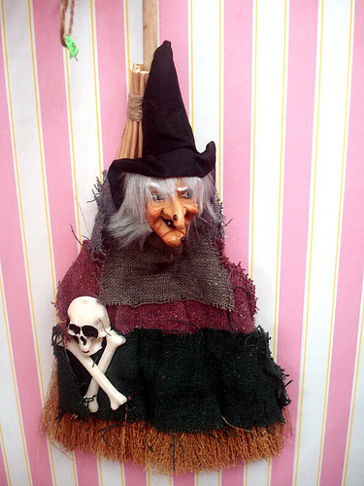
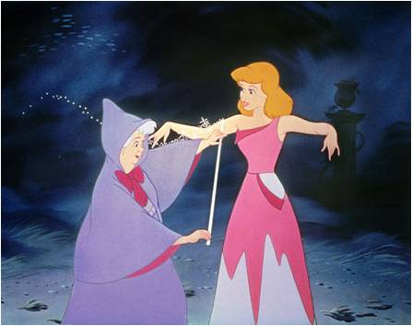
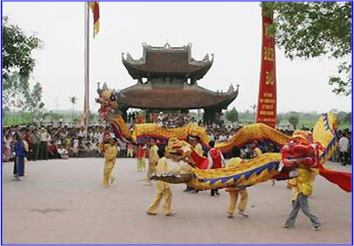
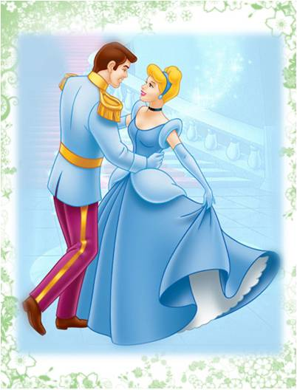
Unit 4: OUR PAST
Read
I. Vocabulary
- cruel (adj):
độc ác
- upset (adj):
buồn phiền
- broken heart (n):
đau lòng
- festival (n):
lễ hội
- prince(n):
hoàng tử
- fairy (n) :
nàng tiên
- rag (n)
quần áo rách
- fall in love with sb:
yêu
- drop (v)
đánh rơi
He is a prince
She is very cruel
She is very upset

Slide 2
The Lost Shoe
“Once a poor farmer had a daughter named Little Pea. After his wife died, the farmer married again. His new wife had a daughter, Stout Nut. Unfortunately, the new wife was very cruel to Little Pea. Little Pea had to do chores all day. This made Little Pea’s father very upset. He soon died of a broken heart.
Summer came and went. In the fall, the village held its harvest festival. That year, everyone was excited as the prince wanted to choose his wife from the village. Stout Nut’s mother made new clothes for Stout Nut, but poor Little Pea had none.
However, before the festival started, a fairy appeared and magically changed Little Pea’s rags into beautiful clothes.
As Little Pea ran to the festival, she dropped one of her shoes and lost it. When the prince found the shoe, he decided to marry the girl who owned it. Of course, the shoe fitted Little Pea, and the prince immediately fell in love with her.”

Slide 3
1. Complete the sentence from the story:
a) Little Pea’s father was a________
b) Little Pea’s mother_______ when she was young.
c) Little Pea ________to do the housework all day after her father got married_______
d) The prince wanted to _____________ a girl from Little Pea’s village.
e) Stout Nut’s mother did not make ____________ for Little Pea.
f) The prince found Little Pea’s ______ shoe.
farmer
died
had
again
marry/ choose
new clothes
lost

Slide 4
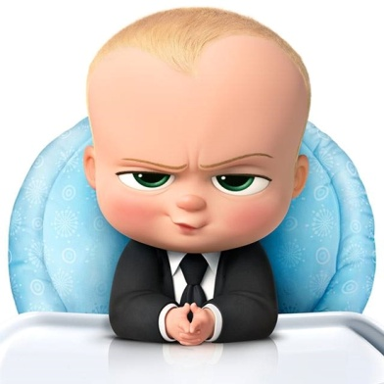
2. Answer the questions.
a. Who was Little Pea ?
b. What did Stout Nut’s mother make Little Pea do all day?
c. How did Little Pea get her new clothes ?
d. Who did the prince decide to marry ?
e. Is this a true story ? How do you know ?

Slide 5
2. Answer the questions.
a. Who was Little Pea ?
She was a poor farmer’s daughter.
b. What did Stout Nut’s mother make Little Pea do all day?
She made her do the chores all day
c. How did Little Pea get her new clothes ?
Before the festival started, a fairy appeared and magically change her rags in to beautiful clothes
d. Who did the prince decide to marry ?
He decided to marry the girl who owned the shoe.
e. Is this a true story ? How do you know ?
No, it isn’t . Because there is a fairy.

Slide 6
Homework
Learn by heart all the new words
Summary the story “The Lost Shoe”
Prepare unit 4: Write

Slide 7
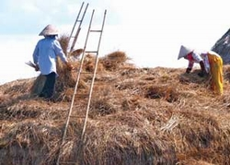
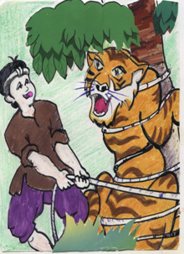
Unit 4: OUR PAST
Write
I. Vocabulary
graze (v)
: gặm cỏ
appear (v)
: xuất hiện
wisdom (n)
: trí khôn
tie (v)
: buộc, trói
straw (n)
: rơm
escape (v)
: trốn thoát

Slide 8
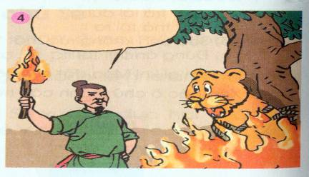
How the tiger got his stripes

Slide 9
1. Complete the story. Use the verbs in the box
burned
escaped
went
was
appeared
left
lit
tied
grazed
said
How the tiger got his stripes.
One day , as a farmer was in the field and his buffalo(0) was grazing nearby, a tiger(1)_________ .The tiger wanted to know why the strong buffalo was the servant and the small man(2)_______ the master. The farmer(3) ______ he had something called wisdom, but he(4)____ it at home that day. He(5)______ to get the wisdom, but before that he(6)______ the tiger to a tree with a rope because he didn’t want it to eat the buffalo. When he returned, the farmer brought some straw with him. He said it was his wisdom. He(7) ______ the straw and the fire(8)_______ the tiger. The tiger(9) _______ , but it still has black stripes from the burns to day.

Slide 10
2. Now, imagine you are a man. Using the words and the pictures to write the story. Start like this:
One day as I was in the field and …
One day / I / field
Buffalo / graze / tiger / come
It / ask / why / strong buffalo / my servant / and I / its master
I / tell / tiger / I have / wisdom
Tiger / want / see / it
I tell / it / I / leave / wisdom / home
Then I / tie / tiger / tree / rope / I didn’t / want / eat / buffalo
I / go / get / straw / and / burn / tiger
Tiger / escape / still have / black stripers

Slide 11
Suggested answer:
One day as I was in the field and my buffalo was grazing nearby, a tiger came. It asked why a strong buffalo was my servant and I was its master. I told tiger that I had something called wisdom. Tiger wanted to see it and I told it I left wisdom at home that day. Then I tied the tiger to a tree with a rope because I didn’t want it to eat my buffalo. I went to get some straw and I burned the tiger. The tiger escaped, but today it still has black stripes from the burns.

Slide 12
- Learn by heart vocabulary.
- Write a folktale that you like best in English
- Prepare Unit 4: Language focus

